Slide 1
Distinctive features of Sikhism

Slide 2
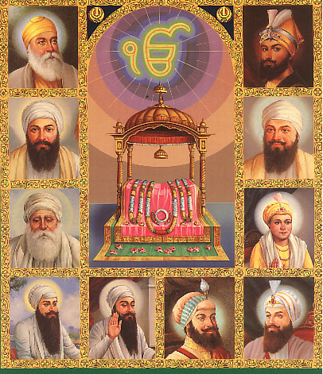
Each prophet gives some light and message to the world.
Guru Nanak Dev Ji, the Founder of Sikhism, and his nine successors made a distinct contribution to religion and religious thought.
Sikhism may be distinguished from other religions from three stand-points:
philosophy, community or institution and physical appearance
Guru Nanak Dev Ji, the Founder of Sikhism, and his nine successors made a distinct contribution to religion and religious thought.

Slide 3
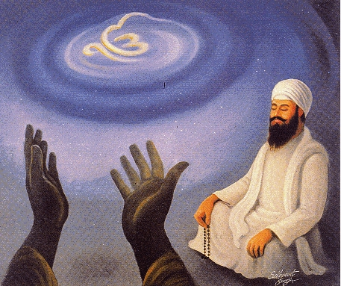
From the philosophical stand-point, the contribution of Sikhism may be called Nam Marg.
Guru Nanak Dev JI emphasized the need for man's devotion to the Timeless Almighty.
He illustrates the attributes of God in his Mul - MuntraHe asks man to dedicate himself, day and night to the remembrance of God and His Name.
"Har kirat utam Nam hai vich kaljug karni sar."

Slide 4
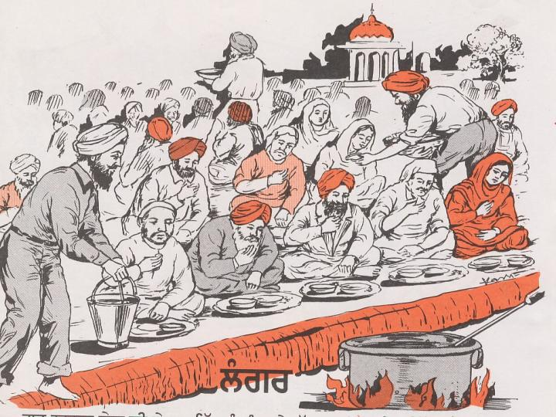
The Guru also gave to his followers the form of a community with certain institutions such as Deg, Teg, and Fateh.
By Deg is meant the system of community kitchen (Langar) maintained by contributions of the Sikhs.
Everyone is to donate one-tenth (Daswand) of his income
Deg is meant the system of community kitchen (Langar)

Slide 5
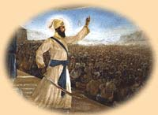
. Teg, is the sword or Bhagwati represents power, which was necessary to preserve freedom of religious worship and to end tyranny.
For this reason, Guru Gobind Singh Ji gave to God among other names, the name of Sarabloh (All steel).
The Sikh believes in God's victory (fateh). the victory is God's and the Khalsa is God's.
Teg, is the sword or power, necessary to preserve freedom of religious worship and to end tyranny.

Slide 6


The Sikh always believes in Chardi Kala, (progress and optimism) in the reform and improvement of society, as a continous process.

Slide 7
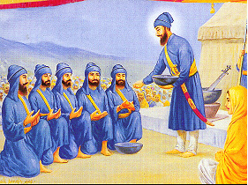
Sikhism also believes in discipline
He infused in him a spirit of fearlessness and a belief in his own invincibility and told him to maintain the five symbols*, symbols are: Hair (Kesh), Sword (Kirpan), Underwear (Katcha), Comb (Kanga), Bracelet (Kara).
.
Guru Gobind Singh Ji gave the Sikh a new appearance and administered him the Baptism of the Sword.

Slide 8
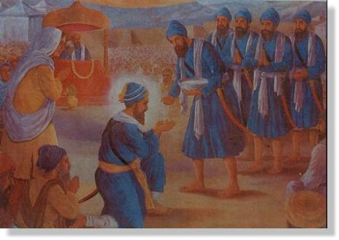
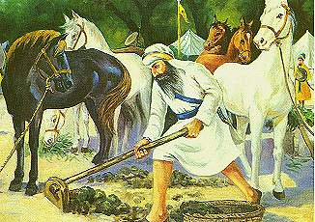
Another tenet of Sikhism is humility (Garibi).
The Gurus asked their followers to regard themselves servants of the Congregation (Sangat).
The tenth Guru, after administering his new baptism to the five chosen ones, asked them on bent knees and with folded hands, to administer baptism (Amrit) to him. In the entire human history, there is no other case of a Guru kneeling before his followers.
Nawab kapoor singh doing sewa even after accepting nawabi

